Slide 1

Microelectronics & HW-SW Co-Design
Zaur Gurbanli Hamida Aliyeva Farhad Gulizada

Slide 2
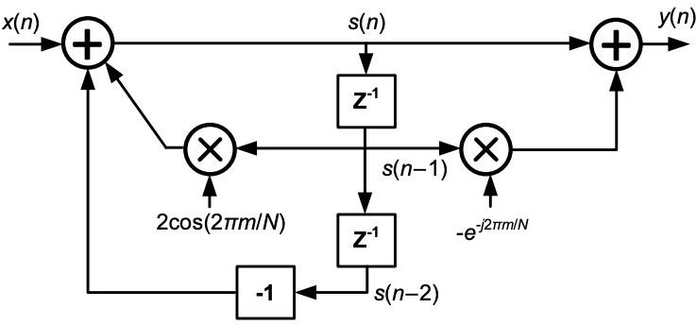
Introduction
What is the Goertzel filter
It was initially developed as an efficient way to compute trigonometric functions.
It computes discrete-time Fourier transform (DTFT) with only two coefficients.

Slide 3
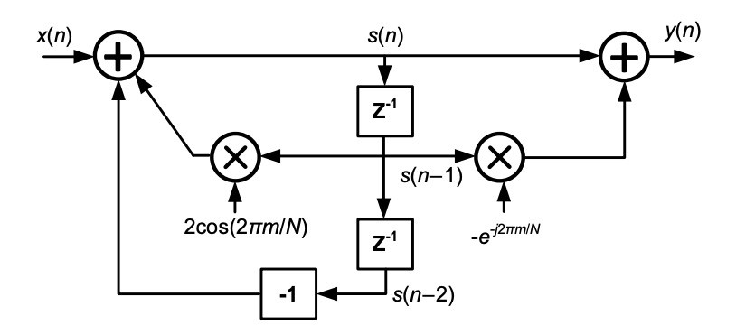
Introduction
The DTFT of a discrete N samples signal x(n) can be rewritten in a recursive form:
𝑦 𝑛 = 𝑊"𝑦 𝑛 − 1
+ 𝑥 𝑛 .
0.
!
"
#!"#$%
where 𝑊! = 𝑒
&
, 𝑛 ∈ 0, 𝑁 , 𝑦 −1 = 0, 𝑎𝑛𝑑 𝑥 𝑁 =
Thus, when 𝑛 = 𝑁:
𝑋 𝑚 = 𝑦 𝑁 .
where 𝑋(𝑚) is the DTFT of the signal 𝑥(𝑛) evaluated at the bin 𝑚 after 𝑁 samples. The z-transform of the recursive equation yields the following transfer function:
𝑌 𝑧 1 − 𝑊"𝑧#$
₌ ! .
𝑋 𝑧
1 − 2 cos ^{2𝜋𝑚} 𝑧#$ + 𝑧#%
𝑁

Slide 4
Introduction
x(N) = 0
Goertzel filter:
Real multiplications: (N+2)K
Real additions: (2N+1)K
Memory required: 3K coefficients
-> one for recursive part, two for feed-forward part
The computation time for estimating a frequency point is (N + 1)T_{s}
Once the N sample input signal is acquired, the Goertzel filter adds one sample period delay before outputting a demodulated frequency point.

Slide 5
Literature review
Dual-tone multi-frequency (DTMF) Detection
This application benefits from the filter’s ability to efficiently detect the dual-tone frequencies generated by telephone keypads
Biomedical Signal Processing
It is used to analyze specific frequency bands in ECG and EEG signals.
Studies have shown its effectiveness in monitoring heart rate and brain wave activities, providing crucial information for medical diagnostics.

Slide 6
Literature review
Industrial Applications
The filter is used in monitoring machinery vibrations, focusing on specific frequencies that indicate mechanical faults.
This application benefits from the filter’s ability to provide real-time frequency analysis with low computational overhead.
Adaptive Filtering
Advances in adaptive filtering have incorporated the Goertzel filter for real-time applications.
An adaptive Goertzel filter for dynamic frequency detection in changing signal environments has been proposed highlighting its potential in modern signal processing tasks.

Slide 7
Literature review
Advantages:
Uses less memory
Simple and easy to implement
Can isolate and measure specific frequencies even in the presence of noise
It focuses on individual frequencies, so precise amplitude and phase information for those frequencies are provided

Slide 8
Implementation
w = 2 * π * targetFreq / sampleRate cosine = cos w
sine = sin w coeff = 2 * cosine
State variables (Q₀ , Q₁ , Q₂ )
Q₁ and Q₂ must be initialized to zero at the beginning
Q₁ = 0 , Q₂ = 0
For every sample, we need to run the following three equations:
Q₀ = coeff * Q₁ – Q₂ + sample Q₂ = Q₁
Q₁ = Q₀

Slide 9
Implementation
After running the per-sample equations N times, it’s time to see if the tone is present or not.
real = (Q₁ – Q₂ * cosine) imag = (Q₂ * sine) magnitude² = real² + imag²
Optimized Goertzel
The optimized Goertzel requires less computation than the basic one, at the expense of phase information. The per-sample processing is the same, but the end of block processing is different.
magnitude² = Q₁ ² + Q₂ ² - Q₁ * Q₂ * coeff

Slide 10
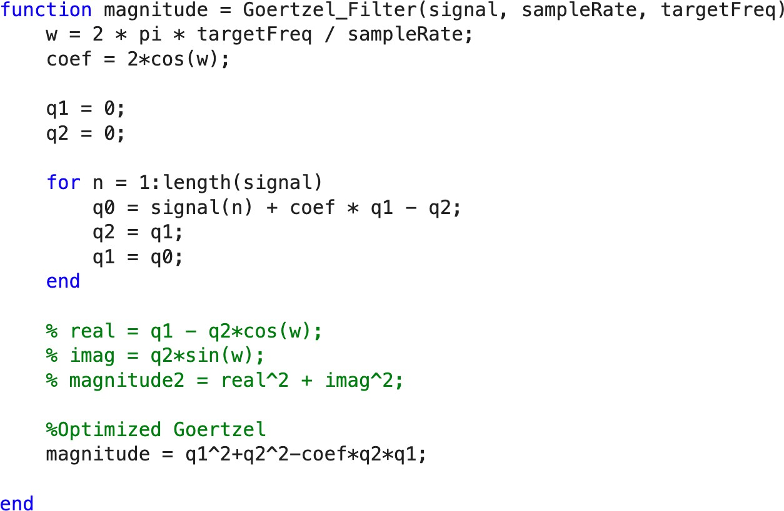
Implementation - Matlab

Slide 11
Simulation – Input Signals
Sine waves
Frequency: 5 kHz, 149 kHz, 150 kHz, 151 kHz, 200 kHz
Phase: 0°, 30°, 45°, 90°, 120°
Square waves
Frequency: 10 kHz, 16 kHz, 150 kHz, 200 kHz
Phase: 0°, 30°, 45°, 90°, 120°
Triangle waves
Frequency: 5kHz, 149 kHz, 150 kHz, 151 kHz, 200 kHz
Phase: 0°, 30°, 45°, 90°, 120
11

Slide 12
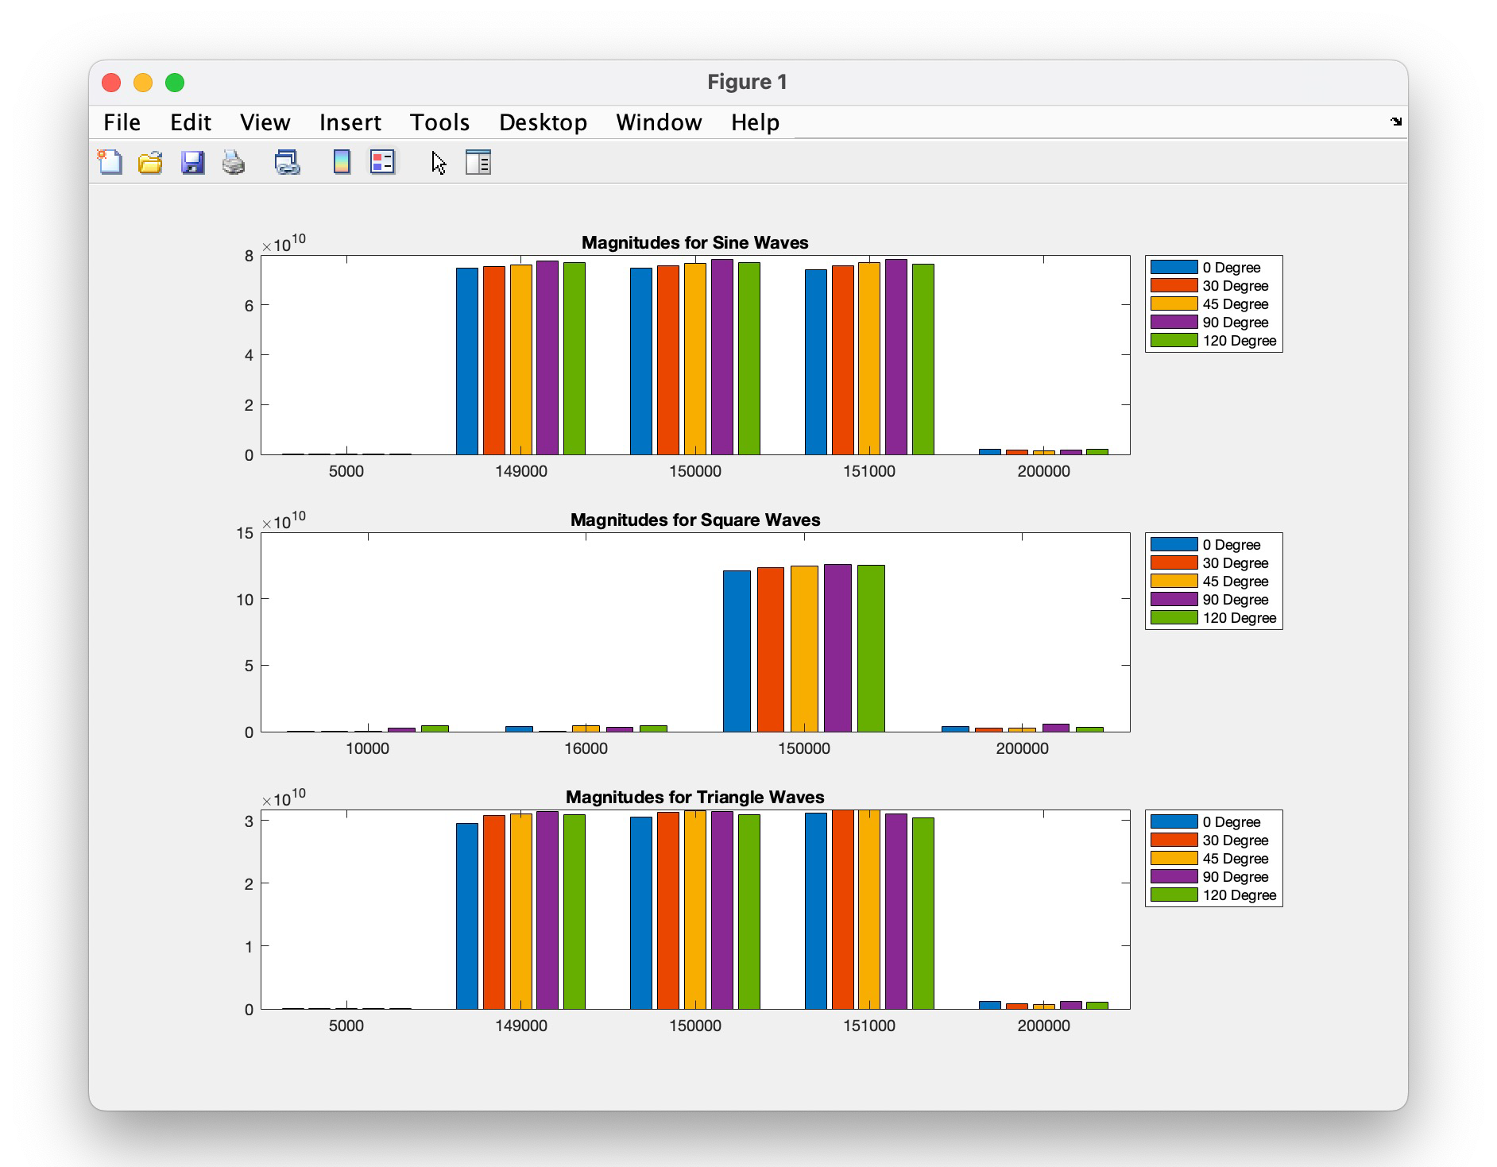
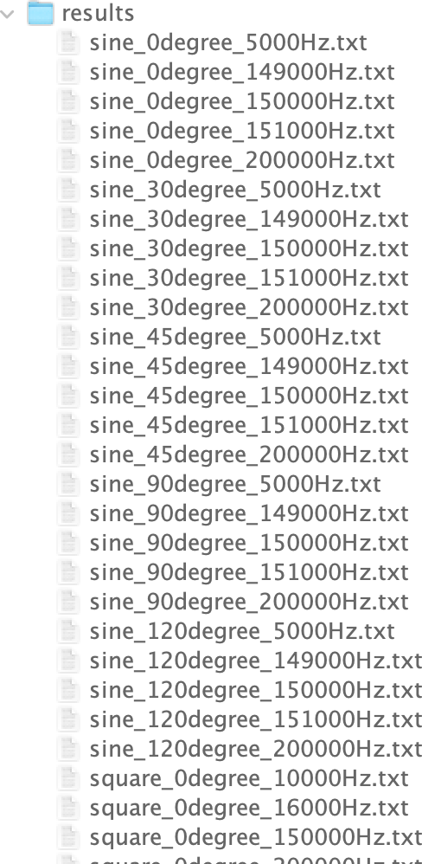
Simulation - Matlab

Slide 13
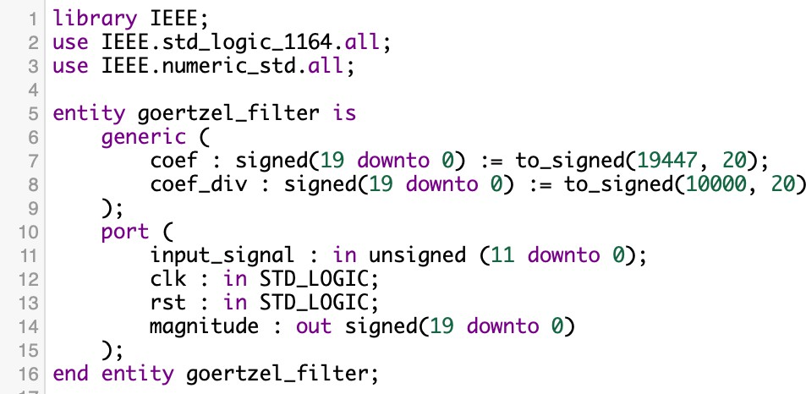
Implementation - VHDL
From matlab code we
find that:

Slide 14
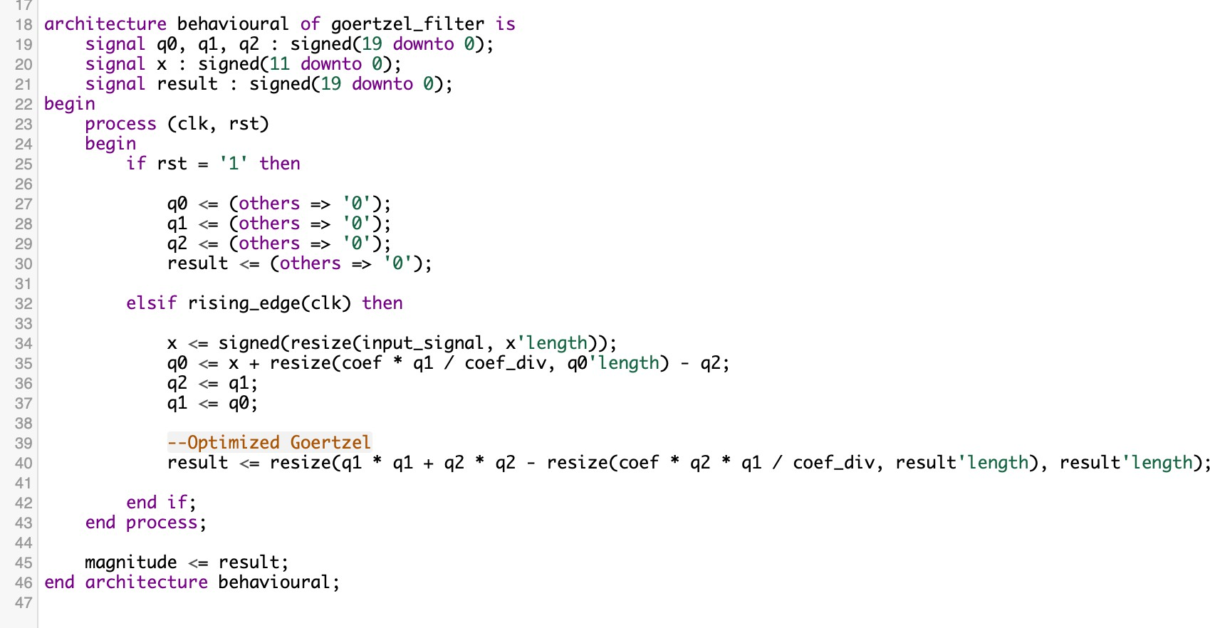
Implementation - VHDL

Slide 15
Testbenchmark implementation
Definitions for standart logic types
Arithmetic operation
I/O handling
Library and Package Inclusions
library ieee;
use ieee.std_logic_1164.all;
use ieee.numeric_std.all;
use std.textio.all;
Entity Declaration
entity tb_goertzel_filter is
end entity tb_goertzel_filter;
Architecture Declaration
architecture tb_arch of tb_goertzel_filter is

Slide 16
Constant and Signal Declarations
constant INPUT_FILE_PATH : string := "input_signal.txt";
constant EXPECTED_FILE_PATH: string := "expected_magnitude.txt";
signal clk : std_logic := '0';
signal rst : std_logic := '0';
signal input_signal : std_logic_vector(11 downto 0);
signal magnitude : std_logic_vector(19 downto 0);
signal expected_magnitude : std_logic_vector(19 downto 0);
signal input_signal_unsigned : unsigned(11 downto 0);
signal magnitude_signed : signed(19 downto 0);
file input_signal_file : text open read_mode is INPUT_FILE_PATH;
file expected_magnitude_file : text open read_mode is EXPECTED_FILE_PATH;
process
begin
wait for 10 ns;
clk <= not clk;
end process;
File path declaration for Matlab-generated files
Signal declaration
File declaration for Matlab-generated files
Clock processing

Slide 17
Reading Input and Expected Data
process
variable input_line : line;
variable expected_line : line;
variable input_value : integer;
variable expected_value : integer;
begin
while not endfile(input_signal_file) loop
readline(input_signal_file, input_line);
read(input_line, input_value);
input_signal <= std_logic_vector(to_unsigned(input_value, input_signal'length));
input_signal_unsigned<=to_unsigned(input_value, input_signal_unsigned'length);
wait until rising_edge(clk);
end loop;
while not endfile(expected_magnitude_file) loop
readline(expected_magnitude_file, expected_line);
read(expected_line, expected_value);
expected_magnitude <= std_logic_vector(to_signed(expected_value, magnitude'length));
wait until rising_edge(clk);
end loop;
wait;
end process;

Slide 18
Instantiating and Comparison
process
begin
-- Wait for filter to settle
wait for 100 ns;
-- Compare magnitudes
assert std_logic_vector(magnitude_signed) = expected_magnitude
report "Mismatch between calculated and expected magnitude!"
severity error;
assert false report "Test done." severity note;
wait;
end process;
goertzel_inst : entity work.goertzel_filter
port map (
clk => clk,
rst => rst,
input_signal => input_signal_unsigned,
magnitude => magnitude_signed
);
=>

Slide 19
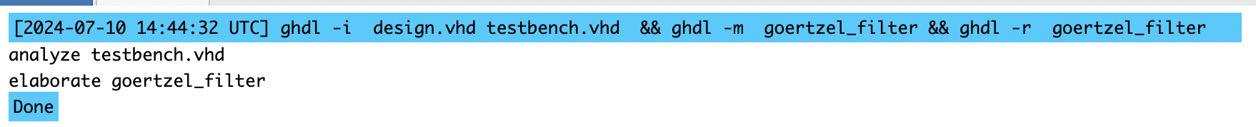
Simulation process
Tools & Means
Linux (ChromeOS) environment(initially)
GHDL 3.0
Eda playground
Files
input signal.txt
expected magnitude.txt
design.vhd
testbench.vhd
Result

Slide 20
References
“A Goertzel Filter Based System for Fast Simultaneous Multi-Frequency EIS” by Louis Regnacq, Student Member, Yu Wu, Member, IEEE, Nazanin Neshatvar, Member, IEEE, Dai Jiang, Senior Member, IEEE, and Andreas Demosthenous, Fellow, IEEE: https://discovery.ucl.ac.uk/id/eprint/10133993/1/goertzel%20filter%20eis_demosthenous.pdf
Digitale Signalverarbeitung mit MATLAB, Martin Werner
https://www.embedded.com/the-goertzel-algorithm/

Slide 21
Thanks for attention!

